Slide 1

Quick ‘N Speedy Delivery
TEAM MEMBERS:​
S.J SUMANTH (2010030377)​
K. SREEVARUN (2010030451)​
E. PAVAN SAI (2010030538)​
E. SHIVA GOUD (2010030542)​
Under the guidance of
DEEPTHI KALAVALA

Slide 2

Outline
Introduction and problem statement
Algorithms
Flow Chart
GITHUB Commits
Work division

Slide 3
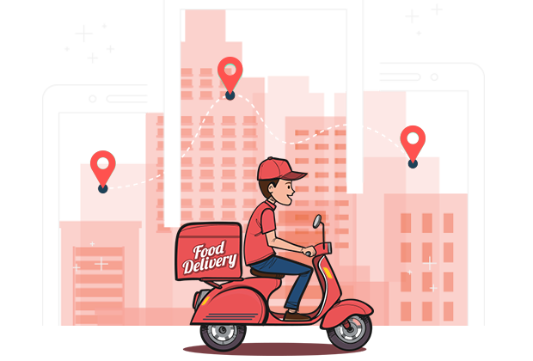
Introduction &PROBLEM STATEMENT
We have many food delivery apps like Swiggy, Zomato, Eat Sure etc.
Daily thousands of orders are made through these apps. In most cases, a driver should take more than one order at a time and deliver the same to respective customers in the given time.
So, in order to deliver all orders at the given time the delivery executive should choose the optimal path from source to destination.
He should delivery in time with minimum distance so he can save his time and get profit .

Slide 4
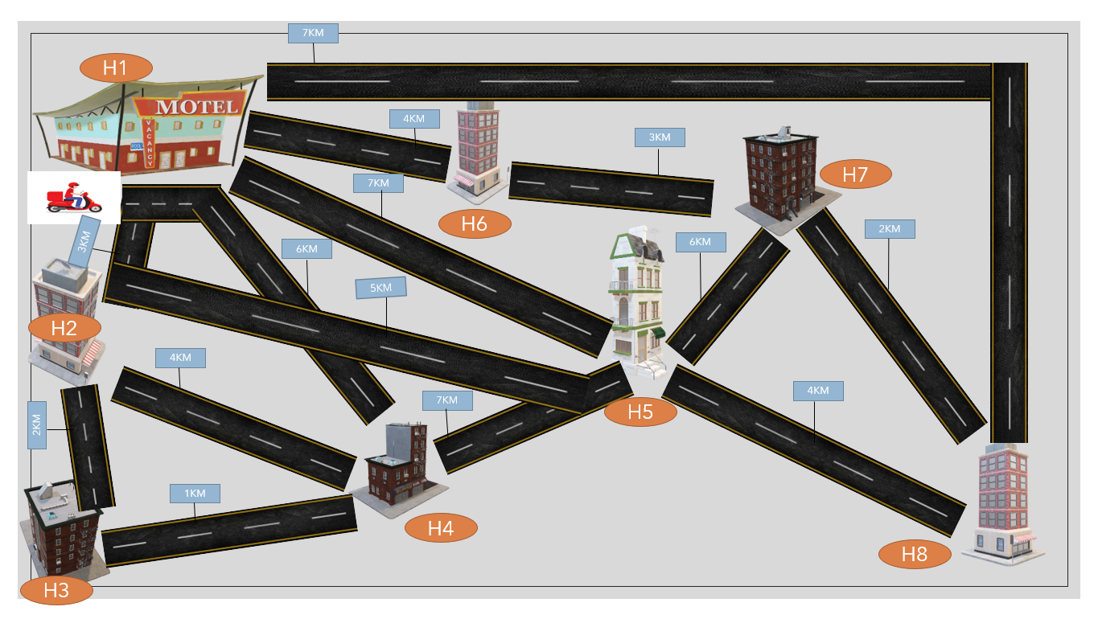

Slide 5

Problem Statement

Slide 6


Slide 7
Algorithms

Slide 8
Ant Colony Optimization
Ant colony optimization (ACO) is a population-based metaheuristic that can be used to find approximate solutions to difficult optimization problems.
The solution construction process is stochastic and is biased by a pheromone model, that is, a set of parameters associated with graph components (either nodes or edges) whose values are modified at runtime by the ants.

Slide 9
Working of Ant Colony Optimization
First, each ant in the colony constructs a solution based on previously deposited pheromone trails.
Next ants will lay pheromone trails on the components of their chosen solution, depending on the solution’s quality.
An ant will often follow the strongest pheromone trail when constructing a solution.
However, for the ant to consider solutions other than the current best, a small amount of randomness is required in its decision process.
In addition to this, a heuristic value is also computed and considered helping to guide the search process towards the best solutions.
In the example of the multiple traveling salesman problem this heuristic will typically be the length of the edge between the destinations being considered - the shorter the edge, the more likely an ant will pick it.

Slide 10
Example

Slide 11
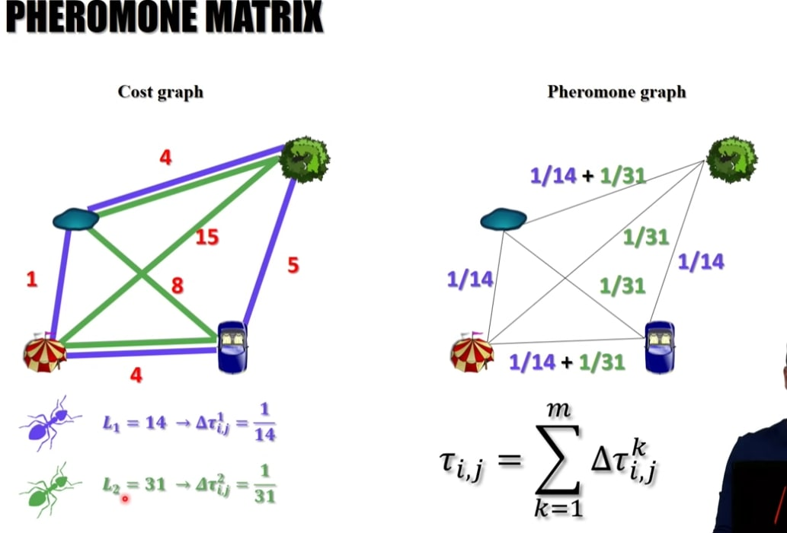
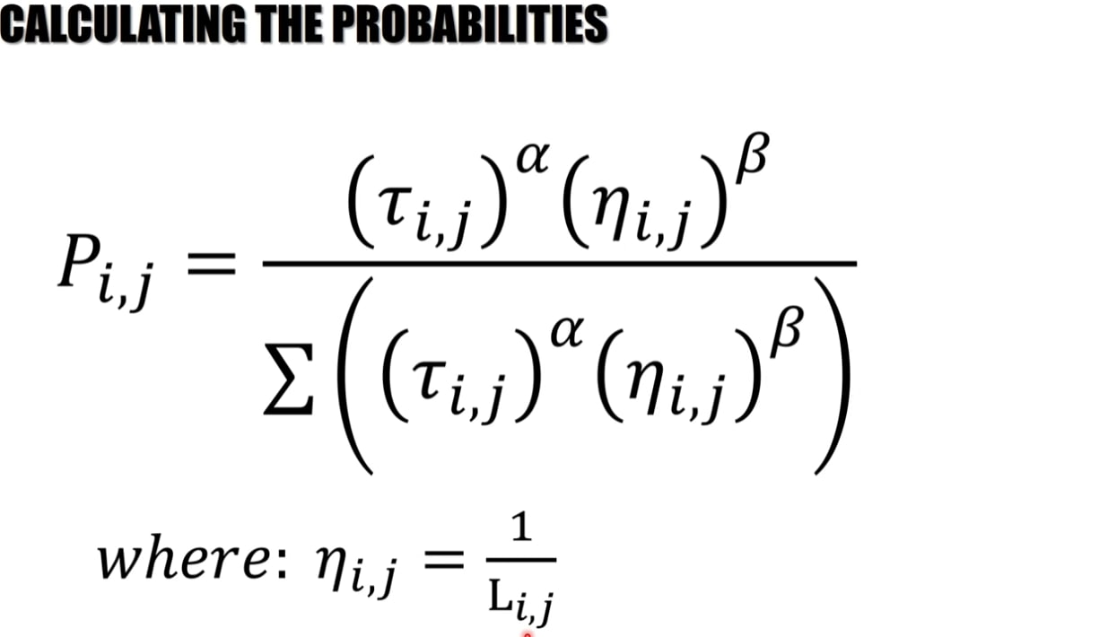

Slide 12
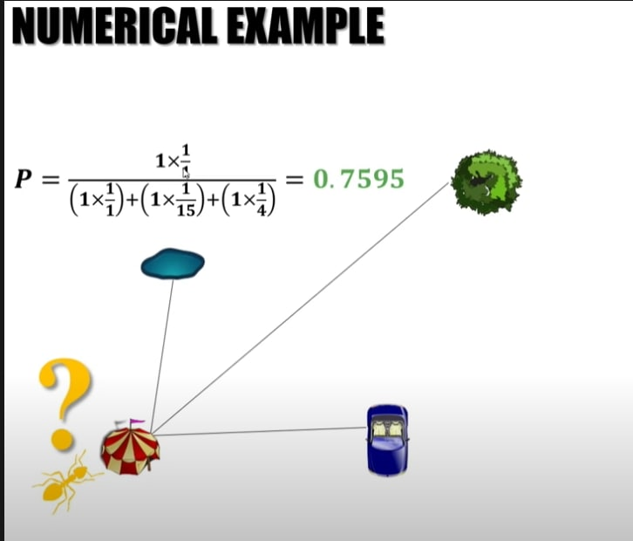
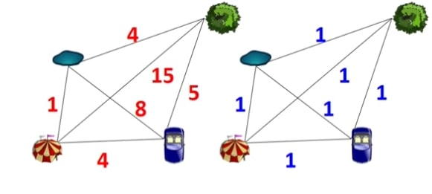

Slide 13
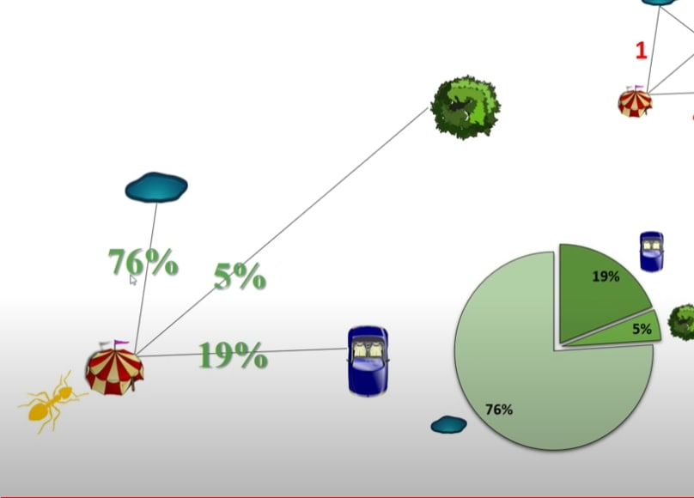

Slide 15
For Travelling Salesman - 1
 | H1 | H2 | H3 | H4 | H5 | H6 | H7 | H8
H1 | 0 | 3 | --- | 6 | 7 | 4 | -- | --
H2 | 3 | 0 | 2 | -- | -- | --- | -- | --
H3 | -- | 2 | 0 | 1 | -- | -- | --- | --
H4 | 6 | -- | 1 | 0 | -- | -- | -- | --
H1→H2→H3→H4→H1

Slide 16
For Travelling Salesman - 2
 | H1 | H2 | H3 | H4 | H5 | H6 | H7 | H8
H1 | 0 | 3 | --- | 6 | 7 | 4 | -- | --
H5 | 7 | -- | -- | -- | 0 | -- | -- | 4
H6 | 4 | -- | -- | -- | -- | 0 | 3 | --
H7 | -- | -- | -- | -- | -- | 3 | 0 | 2
H8 | -- | -- | --- | -- | 4 | -- | 2 | 0
H1→H6→H7→H8→H5→H1

Slide 17

Flow Chart

Slide 18
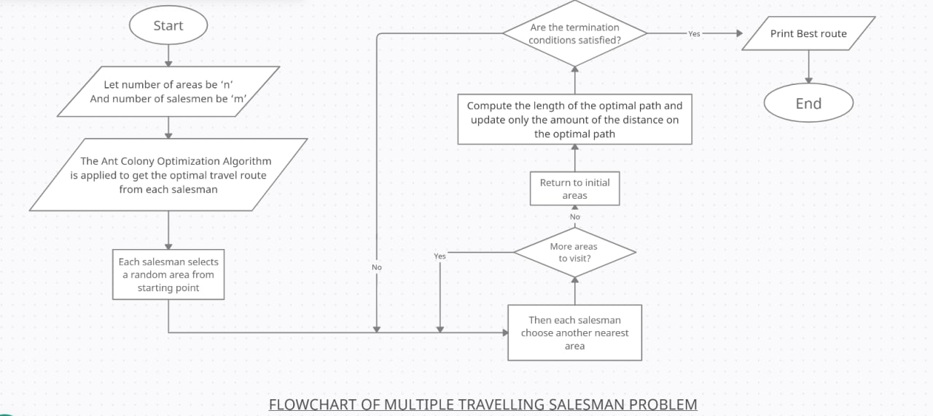

Slide 19
Code

Slide 20
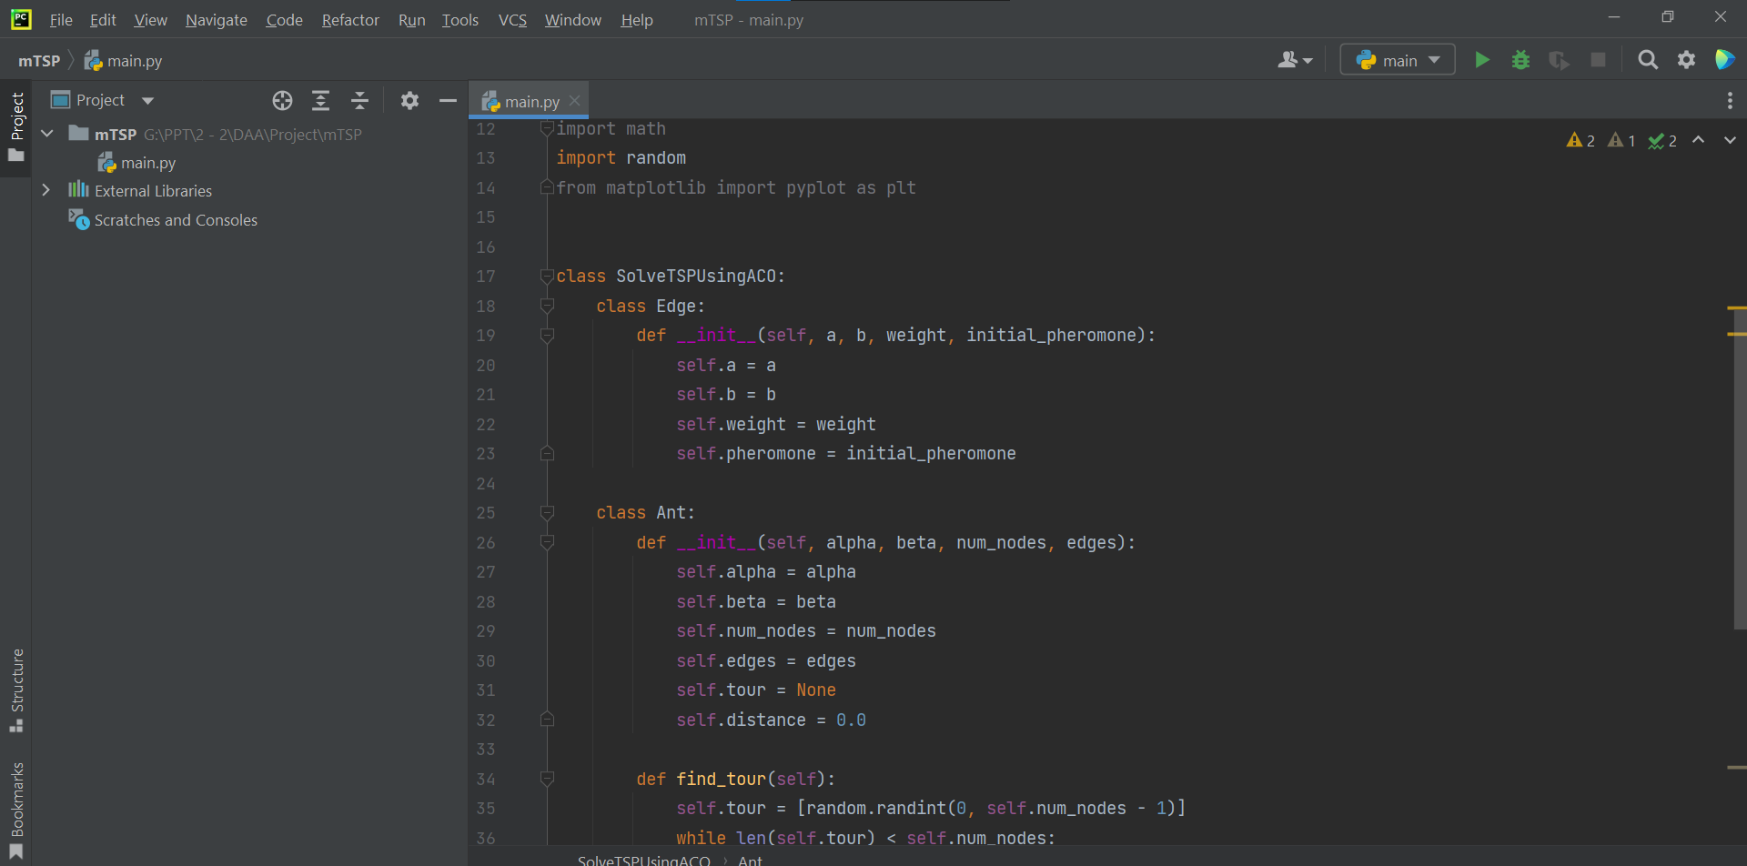

Slide 21
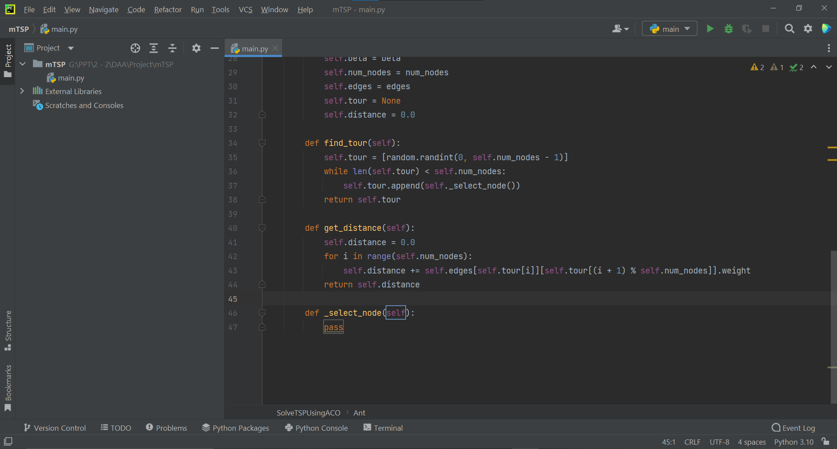

Slide 22
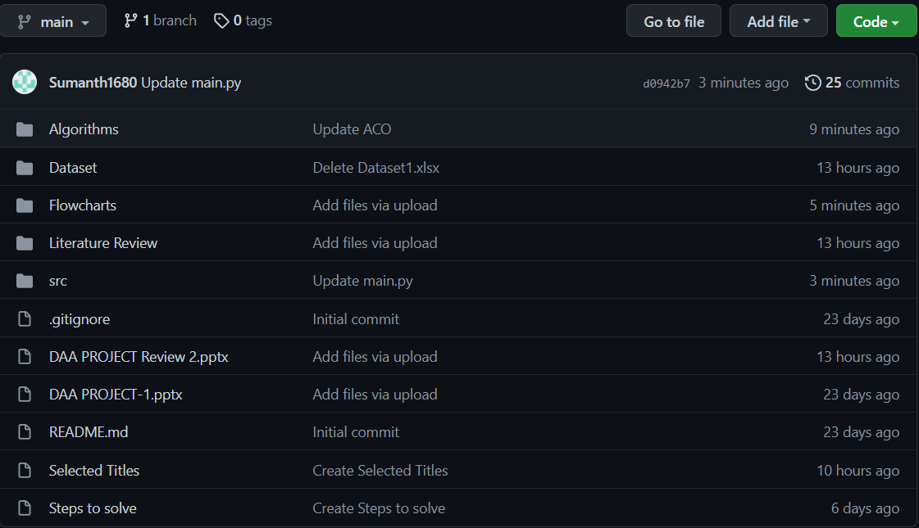
GITHUB Commits
https://github.com/STARTECH-2/Quick-N-Speedy-Delivery.git

Slide 23
Work division
SUMANTH(377)→Information collection, PPT.
SREEVARUN(451)→Information collection.
PAVAN SAI(538)→Information collection.
SHIVA GOUD(542)→Information collection, PPT.

Slide 24


